Slide 1
<number>
Notes:
<number>

Slide 2
Week 4: Making your own WGS pipeline
<number>

Slide 3

Creating a pipeline for WGS analysis

Slide 4
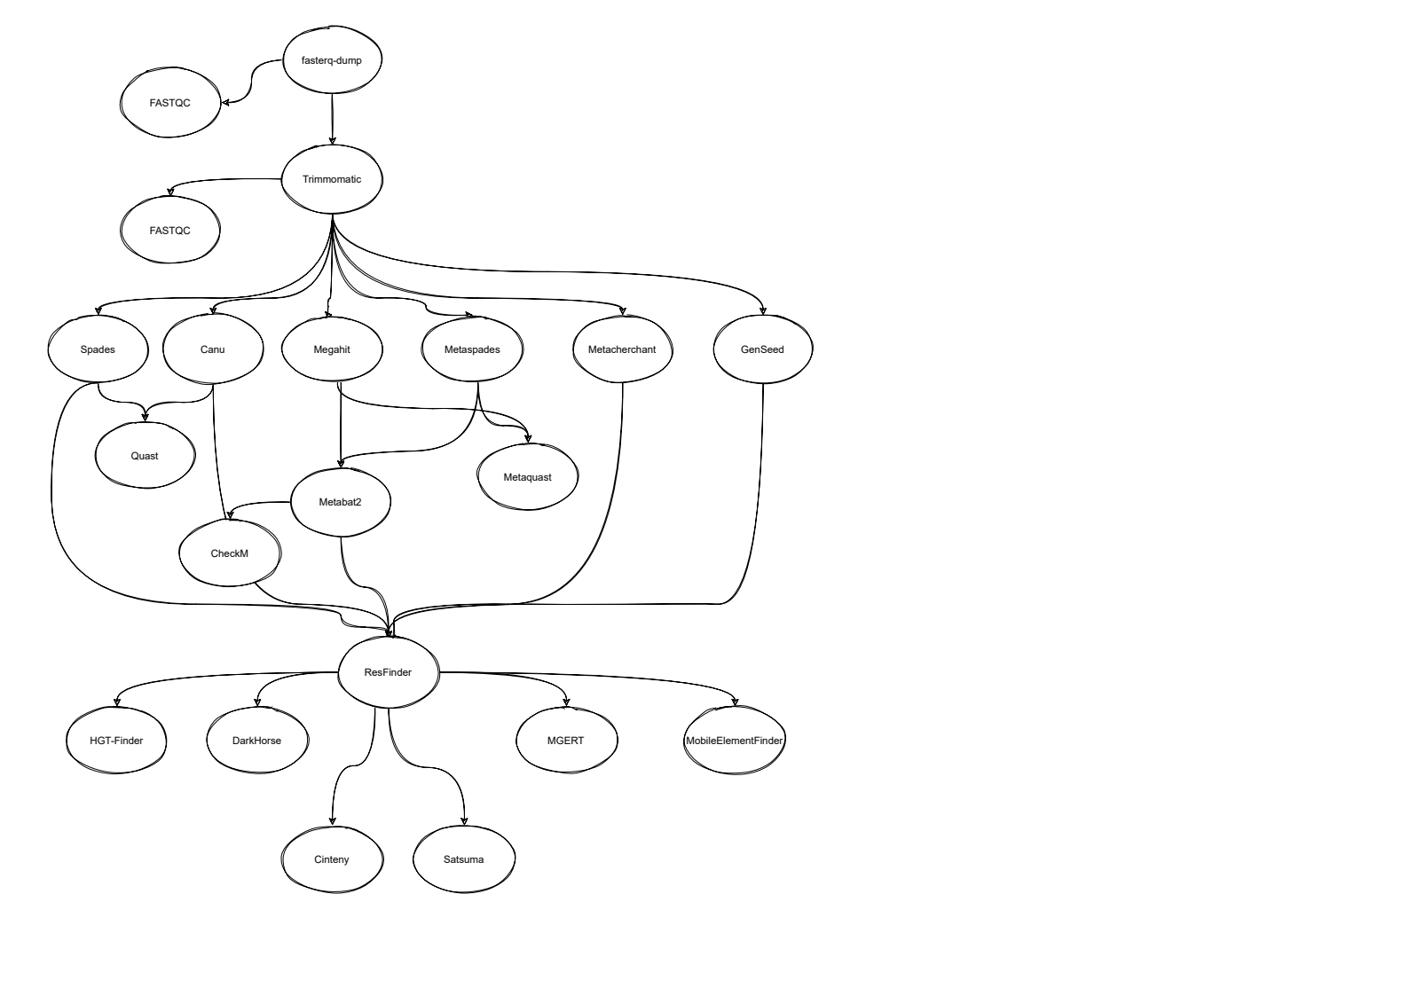
What is a scientific pipeline?
A set of actions which changes the raw data from various sources, to an understandable format so that we can store it and use it for analysis.”

Slide 5

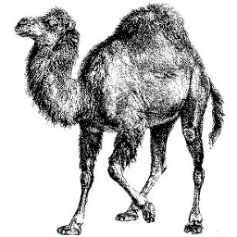

What we were doing before

Slide 6
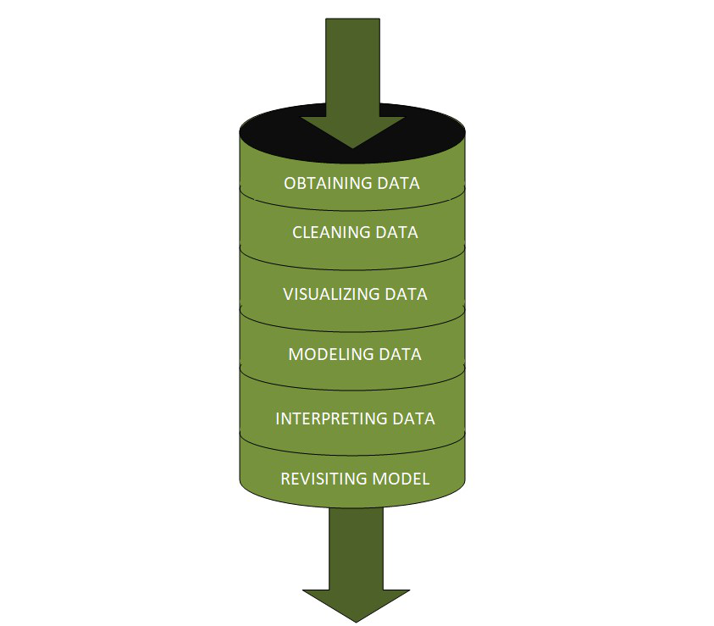
Why do we need scientific pipelines?
Automation
Convenience
Reproducibility
Portability

Slide 7



Workflow managers

Slide 8
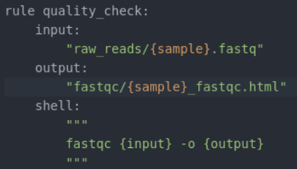

Snakemake
https://snakemake.readthedocs.io/en/stable/
Scientific workflow management system
Working with Python Interpreter
Rules that define how to create output files from input files
Readable
Portable
Scalable
Snakemake executable → Snakefile

Slide 9
Snakemake – Basic example
Basic example
rule bwa_map:
input:
"data/genome.fa",
"data/samples/A.fastq"
output:
"mapped_reads/A.bam"
shell:
"bwa mem {input} | samtools view -Sb - > {output}"
snakemake -np mapped_reads/A.bam
Generalizing the basic example
rule bwa_map:
input:
"data/genome.fa",
"data/samples/{sample}.fastq"
output:
"mapped_reads/{sample}.bam"
shell:
"bwa mem {input} | samtools view -Sb - > {output}"
snakemake -np mapped_reads/B.bam

Slide 10
Snakemake - Expand
Snakemake provides a helper function for collecting input files called expand
SAMPLES=[“A”, “B”]
rule bwa_map:
input:
"data/genome.fa",
expand("data/samples/{sample}.fastq", sample=SAMPLES)
output:
"mapped_reads/{sample}.bam"
shell:
"bwa mem {input} | samtools view -Sb - > {output}"

Slide 11
Snakemake - Scripts
Snakemake also allow the use of customade scripts (Python, R)
SAMPLES=[“A”, “B”]
rule bwa_map:
input:
"data/genome.fa",
expand("data/samples/{sample}.fastq", sample=SAMPLES)
output:
"mapped_reads/{sample}.bam"
script:
"scripts/bwa_script.py"

Slide 12
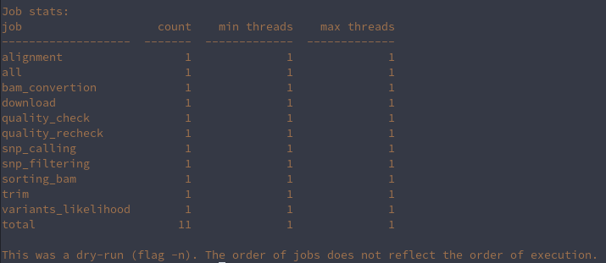
Snakemake – Target rules
How can we execute Snakemake:
snakemake -np mapped_reads/A.bam
Snakemake -np bwa_map (Snakemake accepts rule names as targets if the requested rule does not have wildcards.)
Snakemake -np (Dry run)
Snakemake –cores 1
SAMPLES=[“A”, “B”]
rule all:
input:
”expand("data/samples/{sample}.fastq", sample=SAMPLES)”
rule bwa_map:
input:
"data/genome.fa",
output:
"mapped_reads/{sample}.bam"
shell:
"bwa mem {input} | samtools view -Sb - > {output}"
Moreover, if no target is given at the command line, Snakemake will define the first rule of the Snakefile as the target. Hence, it is best practice to have a rule all at the top of the workflow which has all typically desired target files as input files.

Slide 13
Now go and create your own Snakemake pipeline for exercise 2

